Slide 1
Daedalus Astronautics
Gaines Gibson
Notes:
Name, Rank, Student Org

Slide 2
Mission
To further students’ education and expertise in propulsion related activities
Notes:
Purpose, membership, more about student org, and my job as the intern coordinator

Slide 3
Current Activities
Hybrid Fuel Research
Flight Ready Hybrid Rocket Engine
Small Scale Liquid Rocket Engine
Small and Large Scale Solid Rocket Motors
Ejector Nozzles
ESRA IREC
Outreach
Notes:
Brief overview of activities we have completed

Slide 4
Hybrid Rocket Engine Research
Paraffin Wax Fuel
AP Laced HTPB Fuel
Large scale testing

Slide 6
Liquid Rocket Engine Development
Initial Test Phase
Regeneratively Cooled
Goal of Injector Characterization
Notes:
Just finished machining. Regenerative cooling around the nozzle and combustion chamber. Only liquid we know of in development at a college completely by undergrads. Intent on characterizing the injectors to auto-damp acoustic instabilities.

Slide 7
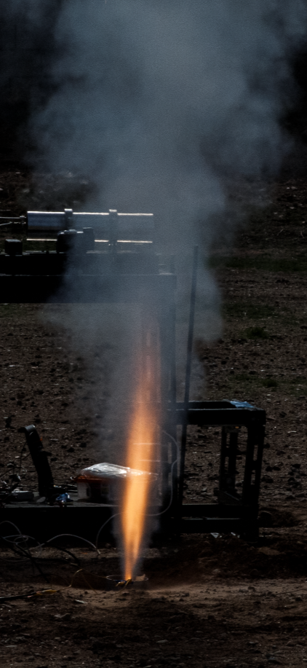
Solid Rocket Motor Research
Characterizing solid rocket propellant by strand burner
Many test fires this year
Large scale tests planned
Multiple in house propellants

Slide 8
Ejector Nozzles
Devices to increase thrust
Never been applied to rockets before
Construction underway

Slide 10
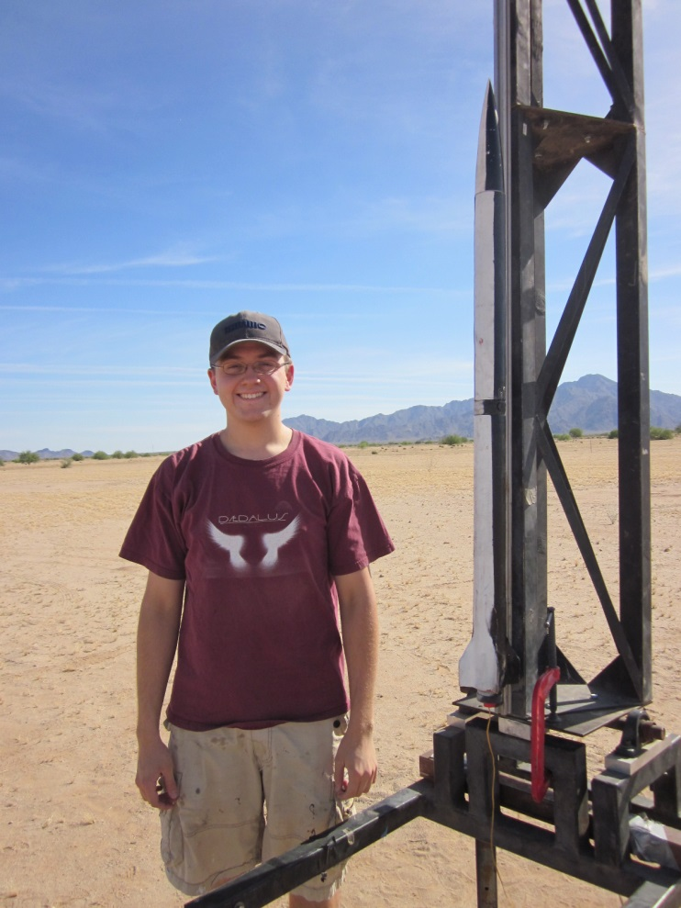
Flying Rockets!
Freshmen compete with drag racers
Students also certify as flyers in the Tripoli Rocketry Association
Flying at ESRA IREC
Notes:
Attempting to certify multiple fliers. Drag racing freshmen rockets.

Slide 11
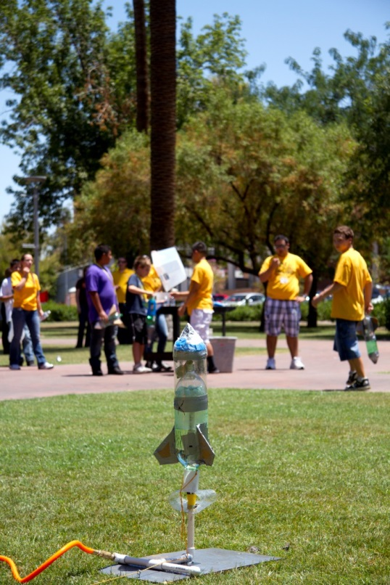
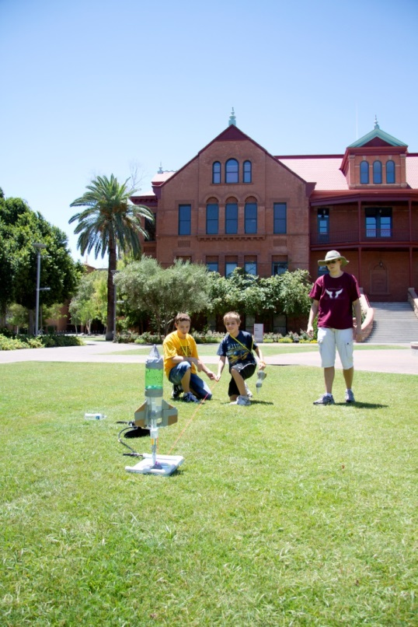
Outreach
Completed outreach to over +2,500 K-12 students
Notes:
Generally do water bottle rockets and Estes kits. Complete 10-15 outreach events per year. Take up Navajo Elementary’s entire 5th grade class to teach them about rockets. They then launch in front of the entire school.

Slide 12
Achievements
Over 30 test fires this school year
Completed 11 test fires in 5 hours
Flew 4 rockets this year, with 5 more planned
4 AIAA Region VI Conference Papers
Two medals for ASU
One AIAA Professional Paper
Huge impact with Outreach

Slide 13
Future Plans
Build and fly a hybrid powered rocket
Being hot fire testing of the liquid rocket engine
Test a large, 75 mm solid rocket motor
Build and test an ejector nozzle
Fly two rockets at ESRA IREC

Slide 14
Questions?

